Slide 1
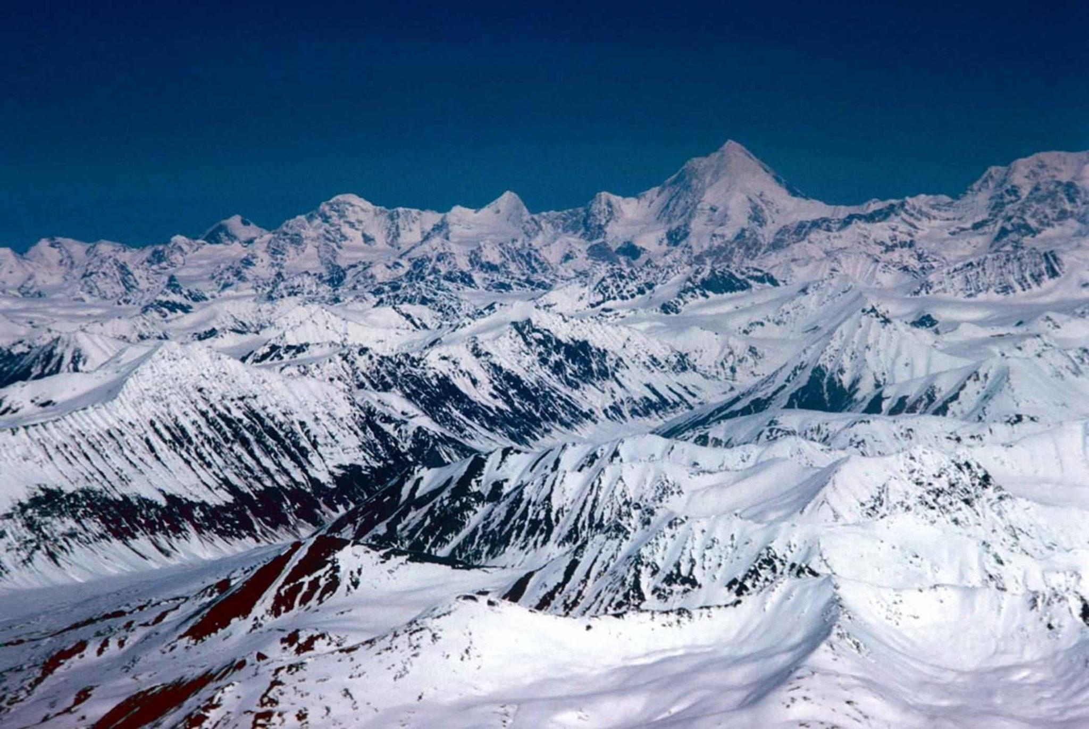
Big Mountain Ski Resort

Slide 2

What is the Issue?
Big Mountain Resort has contacted us in order to determine whether their pricing is appropriate and meets industry standards. Big Mountain Resort will attempt to use data from other resorts across the USA in order to make this determination with the assistance of a Data Scientist.

Slide 3

Recommendations!
Raise Ticket Prices: Based on the information provided above, Big Mountain has grounds to constitute a price adjustment. Big Mountain is advised to increase their ticket price of $81.00 to around $95.87 or just $96.00.
Future Scenarios: The scenarios provided by leadership were queried and responses were returned. Should Big Mountain require additional testing, they may return to this worker and discuss compensation for additional queries.
Further Investigation: Leadership must determine other costs that may affect the key findings in order to reassess any changes they may have on the ticket pricing. Should there be additional costs with additions, then the model should be updated to reflect that. As such, the opposite must also occur.

Slide 4
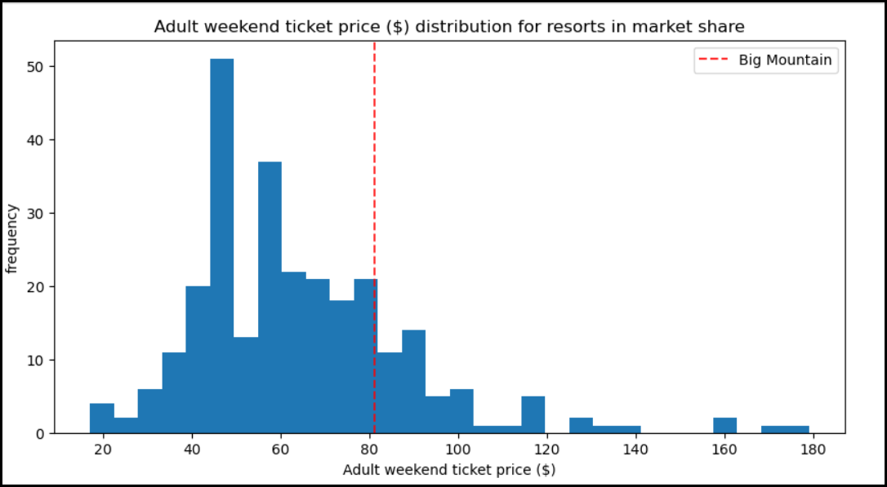
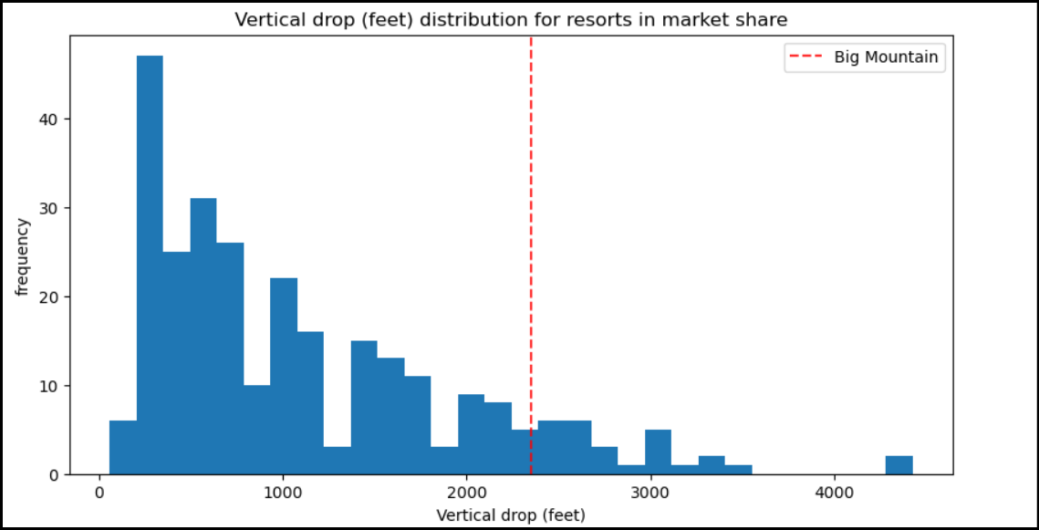
How do we know this to be true?
1. Raise Ticket Prices
- In the above image, you can determine Big Mountain Resort ranks well with other resorts in the data in terms of price. There are fewer resorts with a higher price than there are lower. However, additional data indicates Big Mountain Resort possesses amenities other resorts do not. In this example, Vertical Drop (a sought after amenity for resorts) is much higher at Big Mountain Resort than many other resorts. With other amenities added in, Big Mountain Resort can justify a price increase as stated in the recommendations.

Slide 5
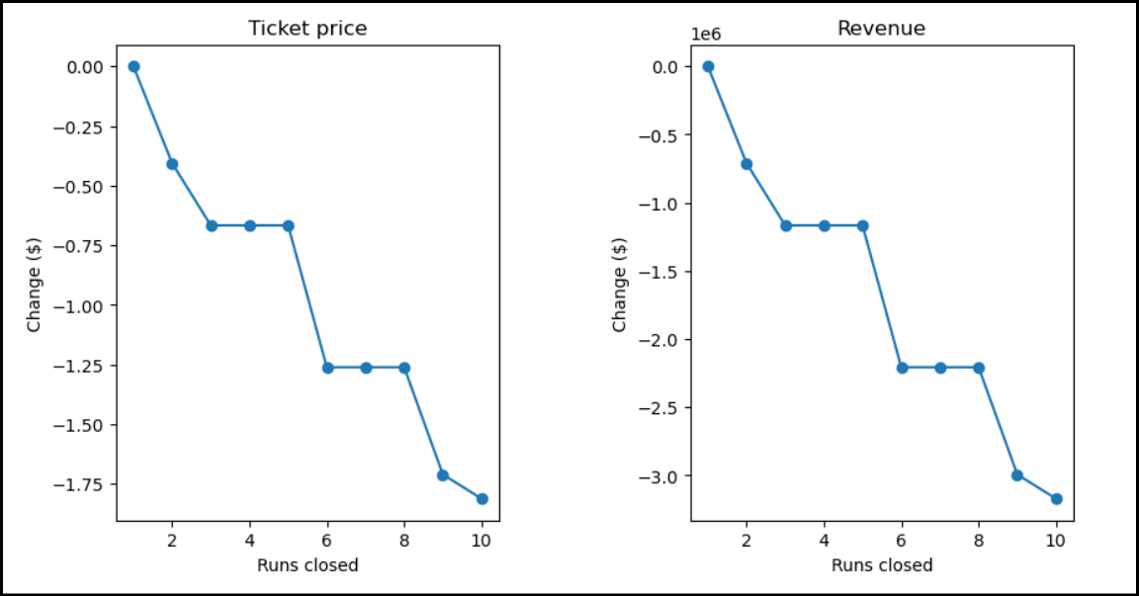
How do we know this to be true?
2. Scenario 1
- In the below images, we were given a scenario of permanently closing down up to 10 of the least used runs. This doesn't impact any other resort statistics. This scenario could not justify the increase of ticket prices. On the contrary, it appears to indicate prices decrease by certain amounts as runs begin to be closed.

Slide 6
How do we know this to be true?
3. Scenario 2
- This scenario consisted of Big Mountain adding a run, increasing the vertical drop by 150 feet, and installing an additional chair lift. After predicting the the outcome, it was determined it would justify a $1.99 increase in ticket prices, a potential $3,474,638 over one season.

Slide 7

By requesting assistance and creating this model, Big Mountain was able to analyze industry data and use it to make data driven changes in terms of their pricing. This data gathered will support an increase in pricing and provide a constant tool to test future scenarios.

Slide 8


